Slide 1

Project 2 – 3D Game
Valeria Gastelum Figueroa, Gurleen Kaur
CSCI310

Slide 2
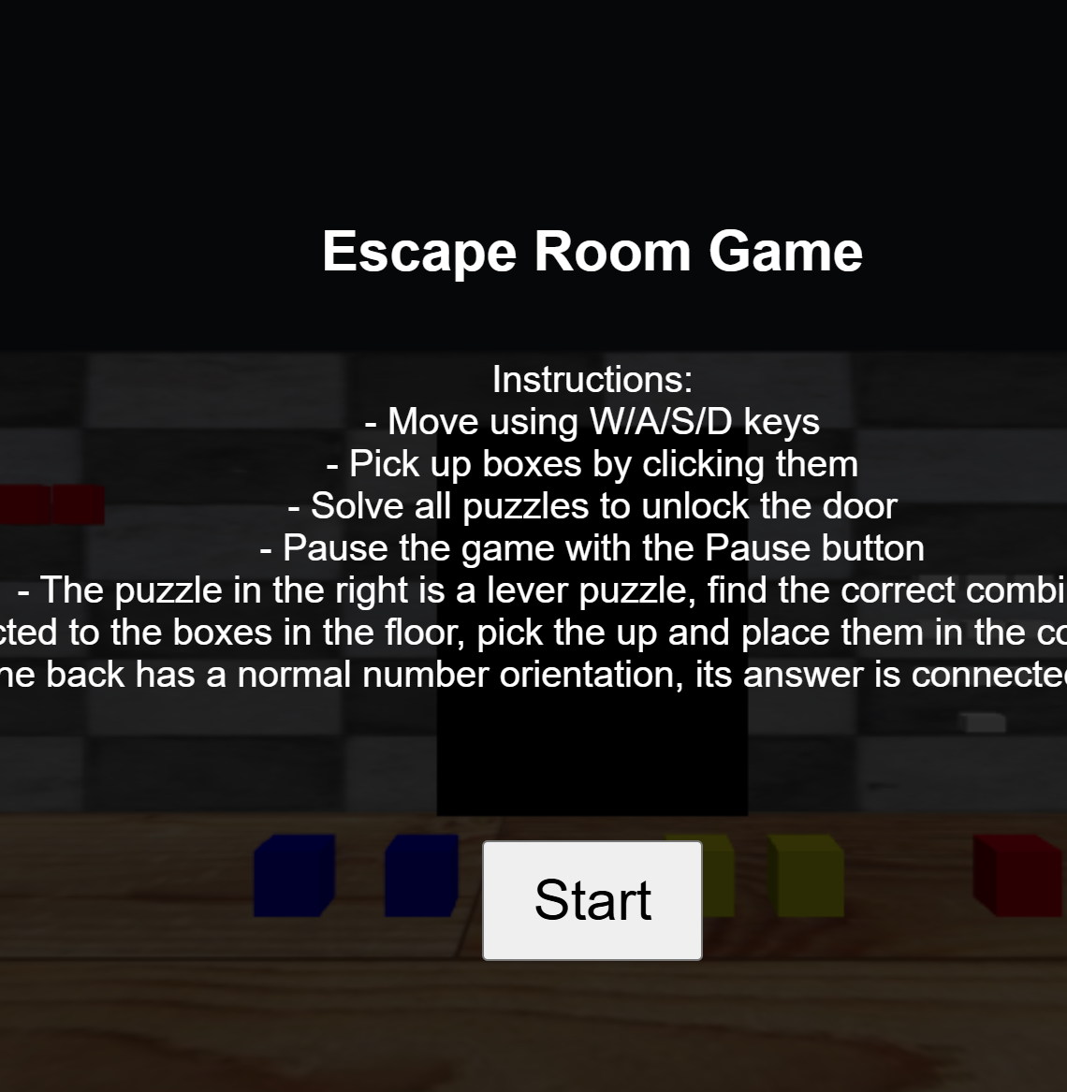
An Escape Room Game
INTRODUCTION – game story
ideation
Requirements & Development
Tasks
Game demo

Slide 3

Game story

Slide 4
The player wakes up in a locked room with puzzles visible, because of a chilling gaze at their back, they decide to move around only looking forward. They will escape from this room.
Story

Slide 5
Ideation

Slide 6
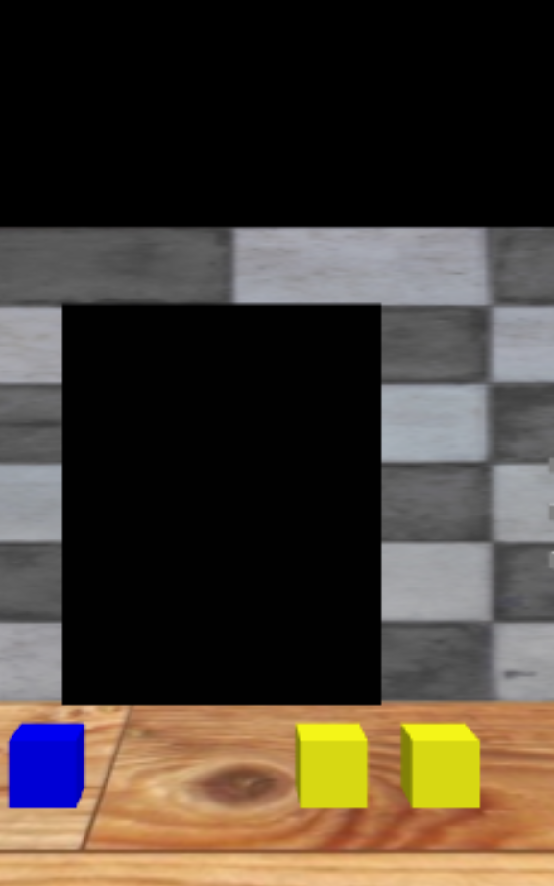
Why an escape room
From the options of simple games to make it was the best.
It was similar enough to the maze_exploration example that we could use it as a guide.
The team members liked the idea of an escape room.

Slide 7
Requirements & development

Slide 8
requirements
Visual & World Building:
First Person
Ambient Lighting
3D objects present
An environment: the room
Interactive elements
Materials - Textures
Interaction & Controls:
Player Input: w/a/s/d
Object manipulation: with the mouse
Physics & Movement:
Collision detection

Slide 9
requirements
Game Flow:
Initialization
Game Loop
Reset Mechanism
Start/End States
Feedback & Scoring
Escape
Time

Slide 10
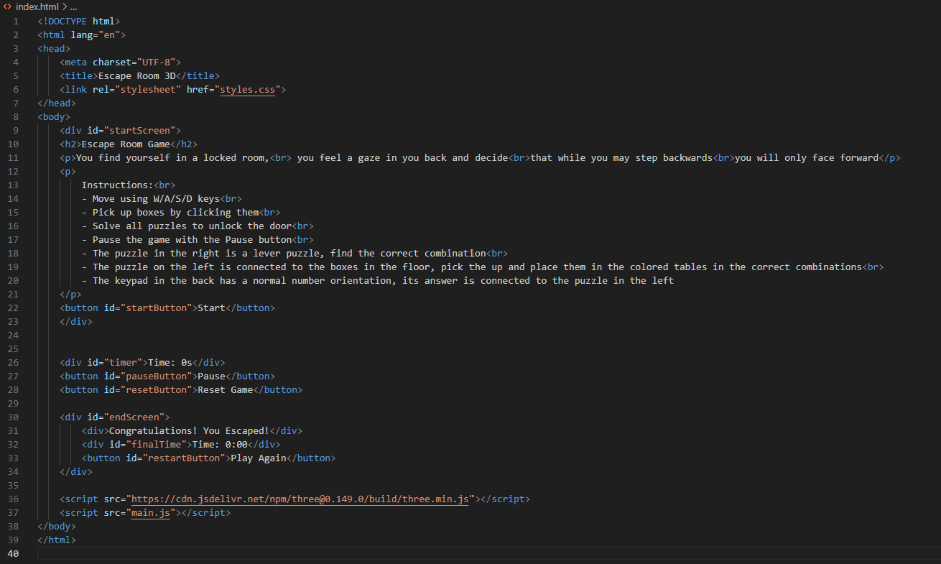
HTML

Slide 11
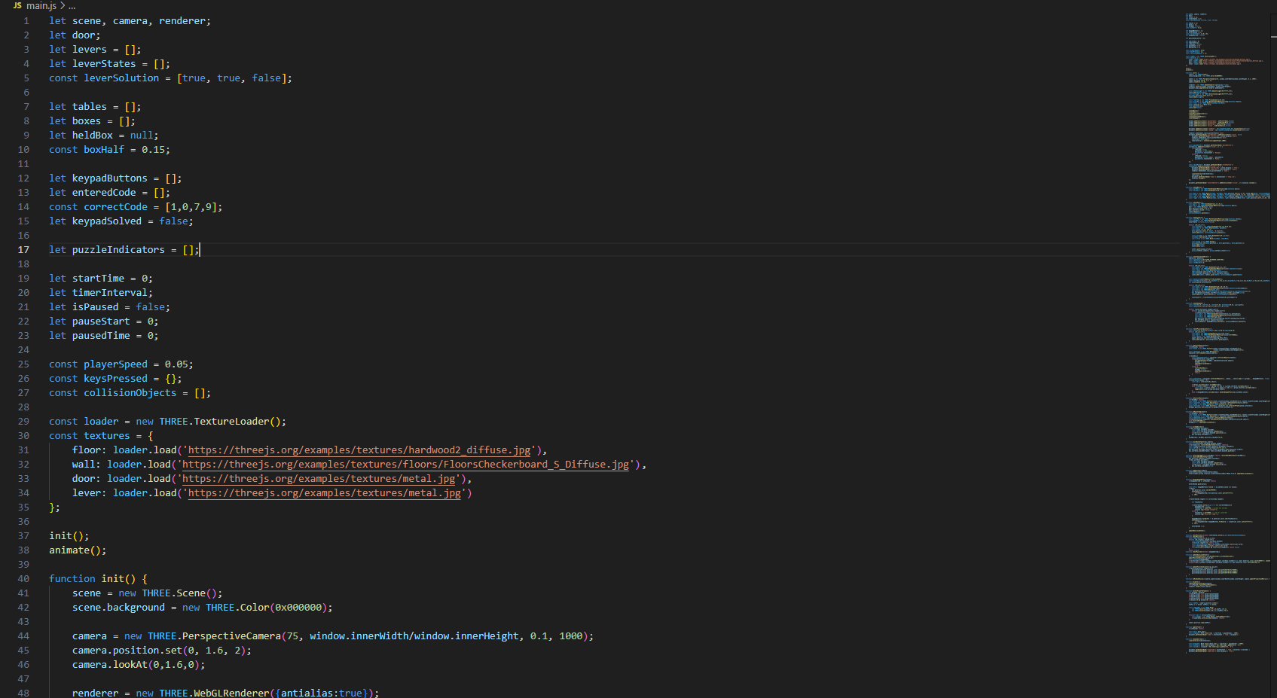
JS

Slide 12
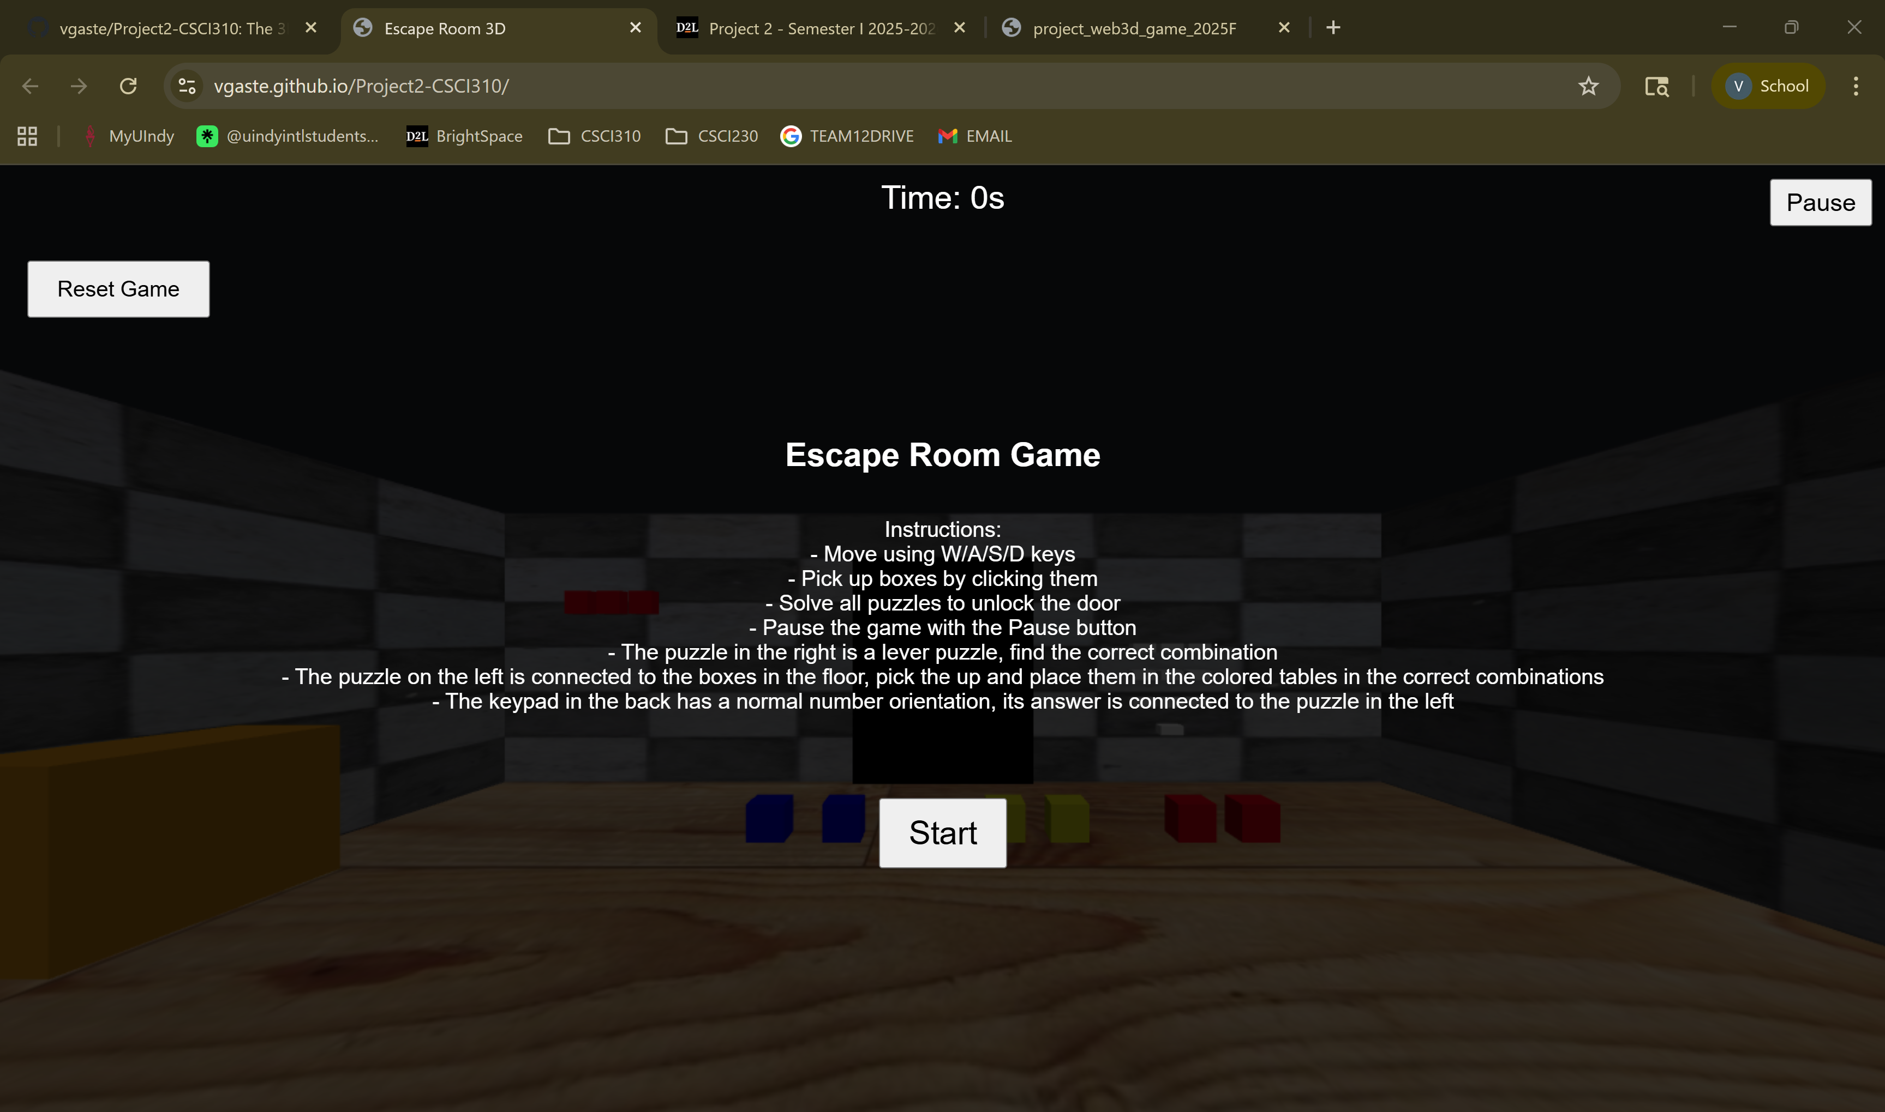

Slide 13
Tasks
Valeria
Initial Room & Puzzle objects
Start/End
Pause/Resume/Restart
Gurleen
Movement Research
Collision Detection Research

Slide 14
Game demo
Link:
https://vgaste.github.io/Project2-CSCI310/

Slide 15

THANK YOU, Questions?

